Slide 1
Language Acquisition
LINGUIST 1: Introduction to Linguistics
Masoud Jasbi

Slide 2
Side Note!

Slide 3
Comprehension vs. Production
One of us, for instance, spoke to a child who called his inflated plastic fish a fis. In imitation of the child’s pronunciation, the observer said: “This is your fis?”
“No,” said the child, “my fis.” He continued to reject the adult’s pronunciation until he was told, “This is your fish.” “Yes,” he said, “my fis.” (Berko & Brown 1960:531)
What does the “fis phenomenon” tell us?

Slide 4


Slide 5
What was happening there?
How was comprehension?
How was production?

Slide 6
The Big Picture

Slide 7
What?!
What is Language?
What does it mean to know a language?
What is the best description of this knowledge?

Slide 8



Why?!
Why do we have language?
How do we acquire this knowledge?
What is it like at the beginning?
What is the relevant input data?
What is it like at the end?
Innate Knowledge
+
Experience
=
Language

Slide 9


Nature
vs.
Nurture
Humans have an innate language faculty (UG)
The input data is impoverished (POS)
Linguistic knowledge arises through the interaction of the language faculty with the input data
Language structure is determined by our innate Universal Grammar
Humans are innately social and communicative
The input data is rich
Linguistic knowledge arises through the application of general cognition to the input data
Language structure is determined by the communicative function of language

Slide 10
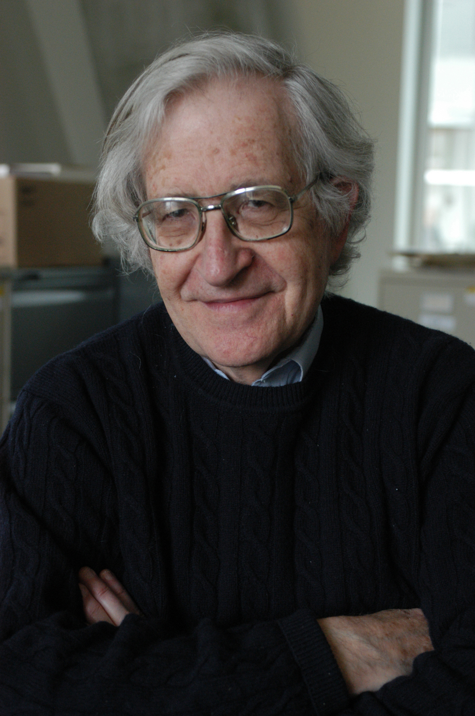
The Nature Side
Prof. Noam Chomsky
Department of Linguistics at MIT
Interests: linguistic theory, syntax, semantics, philosophy of language

Slide 11
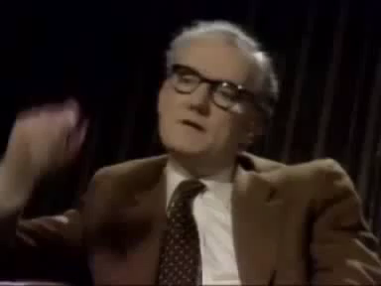

Slide 12

The Nurture Side
Prof. Michael Tomasello
Max Planck Institute for Evolutionary Anthropology
Interests: social cognition, social learning, communication from a developmental perspective

Slide 13
The Nurture Side
Language as a communicative tool and socio-cultural phenomenon.
The knowledge of language is obtained from the use of language (usage-based theories).
Social cognition is the foundation of language learning.
The forms of natural languages are created, governed, constrained, acquired, and used in the service of communication.

Slide 14
Nature-Nurture Interaction
In the rest of the class, we’re going to follow children’s journey through the first three years of their lives and see the interaction of nature and nurture.

Slide 15


Baby To-Do List
Detect Speech
Find the sounds in speech
Find the phonemes of your language
Find bigger chunks like words
Figure out what words mean in context
Put words together to make sentences

Slide 16
When does language learning begin?
Before birth!

Slide 17
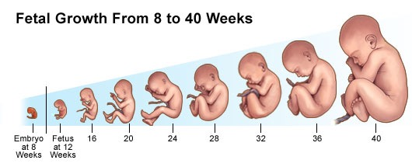
Learning before birth
What is the world of a fetus like?
A human fetus cannot see. Eyes can develop with no exposure to visual stimuli.
This is not the case for ears. The fetus can hear around the 25th week of gestation (6th month of pregnancy).

Slide 18

What does the human fetus hear?

Slide 19
What does the human fetus hear?
Sounds internal to the mother’s body.
Their mother’s voice through her body.
External sounds filtered by the mother’s abdomen:
Low frequencies (below 1kHz).
What linguistic information?
Some aspects of the prosody and the rhythm of the language.
Vowels are generally lower in pitch than consonants.
Voicing information is better transmitted in utero than information related to place or manner of articulation

Slide 20
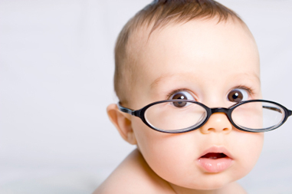
If the fetus is learning, what can we expect the born baby to know?
They should recognize their mother’s voice.
They should know some properties of the vowels of the language spoken around them.
They should be able to distinguish their language from another one based on prosodic information.
But how do you test a baby’s knowledge?!

Slide 21

High Amplitude Sucking
The infant is given a pacifier that is also a pressure sensor.
The intensity and frequency of the infant’s sucking on the pacifier is recorded.
First a baseline is measured, then stimuli are presented to the infant.
Increase in sucking rate is interpreted as sensitivity to the change in the infant’s environment.
Useful for measuring infant reactions up to 0;06

Slide 22
So what do neonates know?
Newborns prefer their mother’s voice to that of another female. (DeCasper & Fifer 1980)
Newborns discriminate a passage read aloud by their mothers during the last six weeks of pregnancy from an unfamiliar one. (DeCasper & Spence 1986)
The familiar passage was more reinforcing, even when read in another woman’s voice.
What does this imply?
Newborns distinguish a passage in their native language from one in another language. (Mehler et al. 1988)

Slide 23
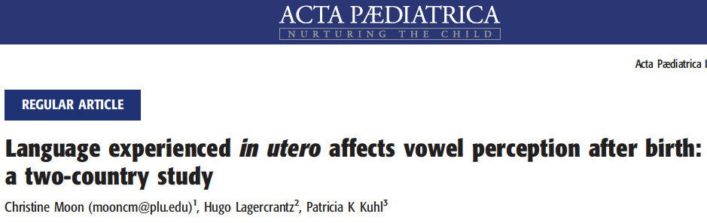
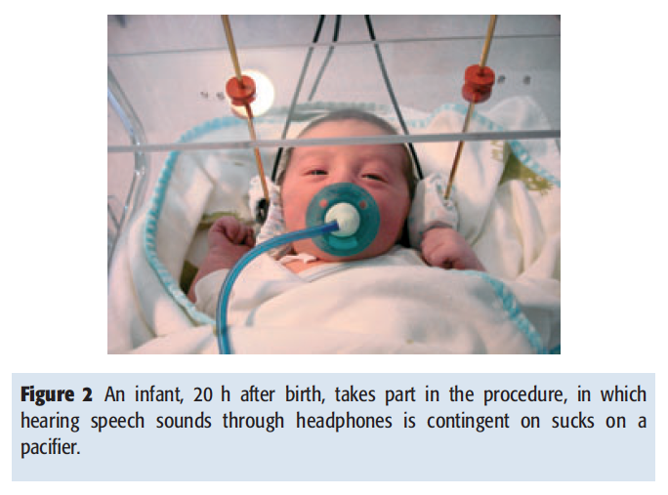
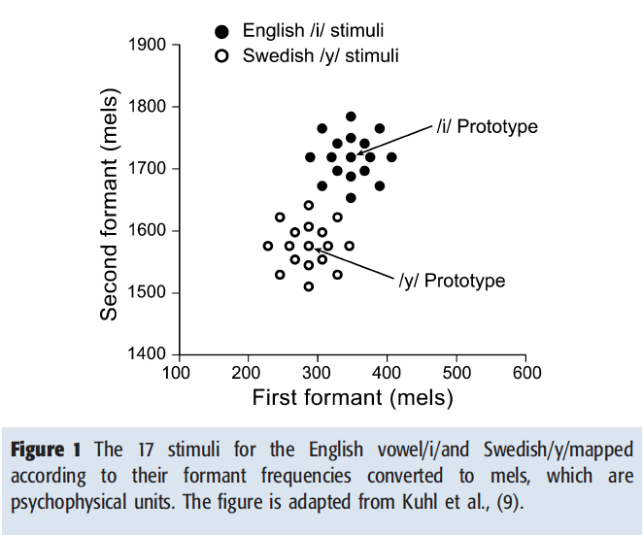
They tested 7-75 hour-old infants in the US and Sweden using HAS on two vowels: one native to English and one to Swedish
In each country, half of the infants listened to the native vowel tokens and the other half to the non-native vowel tokens.

Slide 24
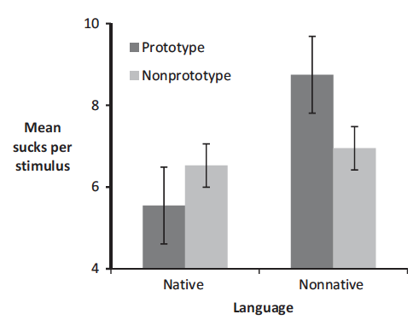
Significantly greater number of sucks when infants heard the non-native sounds, than the native sounds.
Birth is not a benchmark that reflects a complete separation between the effects of nature versus those of nurture on infants’ perception of the phonetic units of speech.

Slide 25
Detecting the Speech Stream

Slide 26
Detecting the speech stream
What does a newborn hear?
A cacophony of sounds: door closing, objects hitting a surface, washing machine, water pouring, music played in the room
The infant needs to detect the speech stream and give it special attention
Analyzing the structure of water dripping does not result in language

Slide 27
Schultz & Vouloumanos (2010) tested infants with 17 Japanese words; infants had never heard Japanese before.
Three-months olds show preference (looked longer) for human speech over
Human communicative sounds (laughter, agreement, inquiring, surprise, disagreement, disgust)
Human non-communicative sounds (sniffs, coughs, hiccups, sneezes, yawns, throat clearing)
Rhesus macaque vocalizations (coos, grunts, screams, etc.)
environmental sounds (bells, breaking glass, water (dripping, boiling, stream, etc.), wind, alarms, hammer sounds)

Slide 28
Baby To-Do List
Detect Speech
Find the sounds in speech
Find the phonemes of your language
Find bigger chunks like words
Figure out what words mean in context
Put words together to make sentences

Slide 29
Finding the Phones

Slide 30
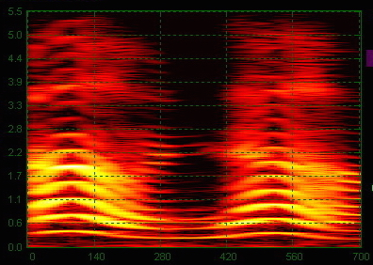
Droplets in the stream
Physical sound has a continuous nature.
Languages use discrete sound categories (phones).
How do infants move from the continuous stream to discrete categories?
“oh no!”

Slide 31
Categorical Perception
The infant brain creates perceptual categories.
It warps our perception by within-category assimilation and between-category dissociation.
A
B
C
D
X
Y
AB = BC = CD
A = B, C = D, but B != C

Slide 32
ba-1
ba-2
ba-3
pa-1
pa-2
pa-3
VOT
ms
-20
0
20
40
60
80
25
We perceive a /b/ if voicing starts within the first 25ms from when the lips open. Otherwise we hear a /p/.
Eimas et al. (1971) tested infants (0;01-0;04) on pairs of syllables like the ones above using HAS.
Each syllable pair differed in 20 ms.
Infants were sensitive to the between-category contrasts but far less sensitive to the within-category contrasts.

Slide 33
ba-1
ba-2
ba-3
pa-1
pa-2
pa-3
VOT
ms
-20
0
20
40
60
80
25
/p/ and /b/ are not phonemic contrasts in Kikuyu (Bantu; Kenya) but 1-month old Kikuyu infants can detect the contrast (Streeter 1976).
English-Canadian infants can distinguish contrasts found in Polish, French, Czech and Hindi (Trehub 1976, Werker & Tees 1984)
Categorical sound perception in humans is most probably an innate capacity (Kuhl 2004:833).
We share categorical perception with other animals like monkeys, frogs, and some rodents and birds.

Slide 34
Baby To-Do List
Detect Speech
Find the sounds in speech
Find the phonemes of your language
Find bigger chunks like words
Figure out what words mean in context
Put words together to make sentences

Slide 35
From Phones to Phonemes

Slide 36
Carving the phonemic distinctions
There are around 800 phonemes in the world languages. (600 vowels and 200 consonants)
Each language only uses a small subset.
How do children carve the space of sound categories into the phonemic distinctions in their native language?

Slide 37
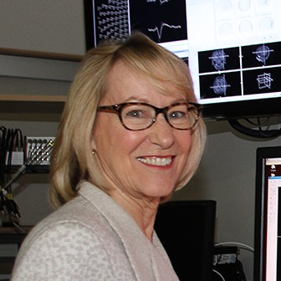
Selecting the native phonemes
Patricia Kuhl explains how babies master the sounds of their native languages.
Prof. Patricia Kuhl
Department of Speech and Hearing Sciences
University of Washington
Interests: infant speech perception, early language and brain development

Slide 38

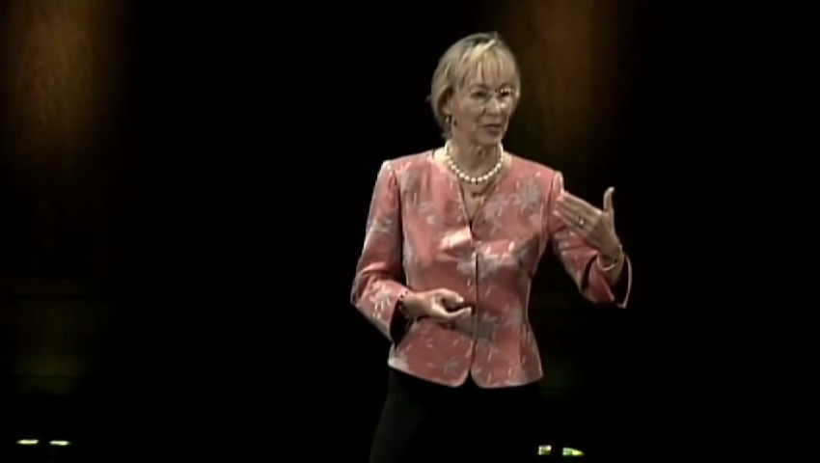

Slide 39

So what did we learn?
Babies are statisticians!
Their mind’s ability of statistical analysis is directed by a social mechanism.
They keep track of the sound distribution in the language(s) that people speak around them.
By 8 months, their minds are biased to process sound with respect to what they know about their native language(s).

Slide 40
Baby To-Do List
Detect Speech
Find the sounds in speech
Find the phonemes of your language
Find bigger chunks like words
Figure out what words mean in context
Put words together to make sentences

Slide 41
Detecting the Words

Slide 42

Chunking the speech stream
How do children extract the larger units like words from the speech stream?
becausewedontreallyhavespacesbetweenwordswhenwespeak
Answer: transitional probabilities between the syllables!
The baby statistician is busy!

Slide 43
Saffran, Newport & Aslin (1996) tested 8-month old infants on an artificial language.
The language had only four 3-syllable words
tupiro, golabu, bidaku, padoti
In a sentence made from these words, the transitional probabilities within word syllables were 1 and between word syllables 0.33.
go
1
la
1
bu
0.33
tu
1
pi
1
ro
bi
da
ku
0.33
0.33
pa
do
ti

Slide 44
They first let infants listen to a sequence of these words for two minutes.
padotigolabupadotibidakutupirotupirogolabu…
Then they tested the infants using HAS on
words: padoti
non-words: tidopa
part-words: dotigo
Infants listened more to non-words compared to words.
They also listened more to part-words compared to words.
What does this mean?

Slide 45
Infants in this experiment managed to extract chunks using transitional probabilities.
So perhaps infants can use the distributional properties of languages to extract words and even bigger chunks.
Now put on your skeptical hat! Do you see any problem with this account?
Hint: what were the transitional probabilities in the artificial language? How does that compare to natural languages?

Slide 46
Baby To-Do List
Detect Speech
Find the sounds in speech
Find the phonemes of your language
Find bigger chunks like words
Figure out what words mean in context
Put words together to make sentences

Slide 47

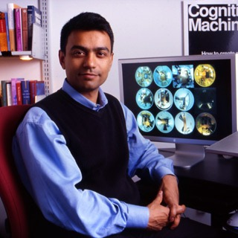
The birth of a word
Production of “water” from “gaga” took half a year for Deb’s son.
Prof. Deb Roy
Media Arts and Sciences at MIT
Interests: language, games, social dynamics, cognitive psychology

Slide 48
Mapping Words to Meanings

Slide 49
Mapping Words to Meanings
Children learn the meaning of words as early as seven months old.
They produce their first recognizable words around their first birthday.
Production is slow and takes a lot of practice.
For example, half a year to go from gaga to water!
But how do they figure out what a word means?

Slide 50
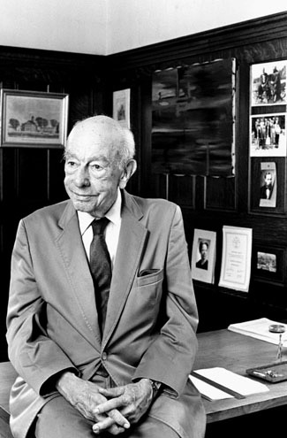
The Gavagai Problem
Philosopher W. V. Quine (1908-2000)
in Word and Object (1960)
Indeterminacy of Translation:
Suppose you are a field linguist and you discover a new language in a completely isolated tribe.
You travel there to learn about the language.
You are walking with a native speaker of the language in the forest when you see …

Slide 51
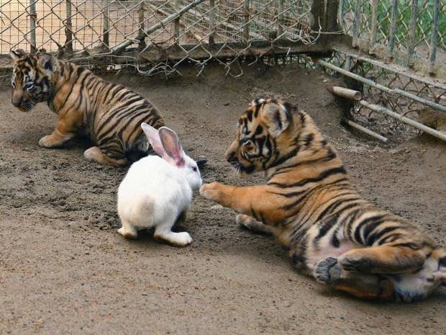
Gavagai!
Tiger!
Herbivore!
White-rabbit!
Rabbit-tiger-mud
What is the meaning of Gavagai?
Rabbit!
Tail!
Dangerous!

Slide 52
Possible Solutions
Cross-situational Learning
Gavagai!
Default Assumptions:
Tiger!
Whole Object
Herbivore!
Taxonomic
White-rabbit!
Basic Level
Rabbit-tiger-mud
Pragmatic Factors:
Rabbit!
Tail!
Joint Attention (Gaze Direction)
Physical & Conversational Co-presence
Dangerous!

Slide 53
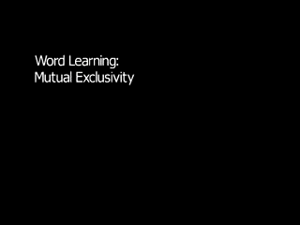

Slide 55
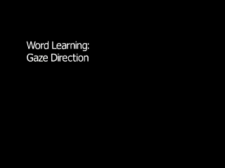

Slide 56
Baby To-Do List
Detect Speech
Find the sounds in speech
Find the phonemes of your language
Find bigger chunks like words
Figure out what words mean in context
Put words together to make sentences

Slide 57
From Words to Sentences

Slide 58
Language as a productive system
Children can memorize “words” and their meanings and keep them in their mental “lexicon”.
But they cannot simply memorize the sentences of a language.
(why?)
We can comprehend and produce novel sentences we have never heard before.
“Language makes infinite use of finite means.”

Slide 59

The Nature Side
Prof. Steven Pinker
Department of Psychology at Harvard
Interests: language acquisition, language and cognition, nativist theories of acquisition, syntactic acquisition, semantic bootstrapping, etc.

Slide 60

Video by The Floating University

Slide 61
Children have a productive knowledge of language.
They make novel forms out of known ones.
12-18 months: the one word stage
Gesture + Word: Ball + reaching
~ 18 months: two-word stage.
e.g. Finger stuck.
~ 24 months: multiword utterances and overgeneralization
e.g. He sticked it.

Slide 62
Acquisition of Syntax
How do we know the sentences of our language?
We don’t! We know the rules that generate the sentences of our language.
We test the novel sentences we hear against these rules.
if they follow the rules, they are grammatical
if not they are ungrammatical.

Slide 63
Acquisition of Syntax
OK! But how do we know the syntactic rules of our language?
No child hears grammar rules! They only hear sentences.
How do children come to know these rules?
Two answers:
Universal Grammar
Domain General Learning/Reasoning Mechanisms

Slide 64
Universal Grammar
Our innate language specific knowledge. Possible candidates:
Phrase Structure Dependence
Syntactic categories: e.g. N, V, ADJ
Head-Direction: Final/Initial
Poverty of the Stimulus: the linguistic data available to the child is not rich enough to allow the learning of the highly abstract grammatical rules.

Slide 65

Structure Dependence
Input to the child:
S: The boy is crazy!
Q: Is the boy crazy?
Two Hypotheses:
Move the first Aux (order)
Move the main Aux (structure)

Slide 66
Structure Dependence
S: The boy who is running is crazy!
Q-Order: *Is the boy who _ running is crazy?
Q-Structure: Is the boy who is running _ crazy?
If children ever hypothesize an order rule, they should make systematic errors like the one above.
Children make such errors very very rarely.
Nativist: Children already know they should look at the structure.

Slide 67
The Usage-Based Account
The structure of a sentence corresponds to the type of information it carries.
New information is carried by the main clause.
Peripheral information is carried by the relative clause.
In questioning “the boy who is running is crazy”, you are not questioning the peripheral information that “the boy is running”.
You are questioning the main point that “the boy is crazy”.
Therefore, the corresponding main Aux needs to be fronted.

Slide 68
The debate continues …

Slide 69
Baby To-Do List
Detect Speech
Find the sounds in speech
Find the phonemes of your language
Find bigger chunks like words
Figure out what words mean in context
Put words together to make sentences

Slide 70
The finale!
The linguistic theory helps us understand the final stage in language development.
Chomsky (1969): "There is little point in speculating about the process of acquisition without a much better understanding of what is acquired."
It also helps us speculate about the possible innate initial stage and steps of development.
Experimental work in language acquisition helps us test these speculations and come up with more realistic ones.
It also helps us better understand what counts as relevant data for learning.

Slide 71
And …
If you are interested in the issues discussed here you might like to take other courses in language acquisition and development:
LINGUIST 140: Language Acquisition I (Eve Clark)
LINGUIST 141: Language Acquisition II (Eve Clark)
PSYCH 60: Introduction to Developmental Psychology (Mike Frank)
Join the Acquisition Lab!

Slide 72
Thank You!

Slide 73
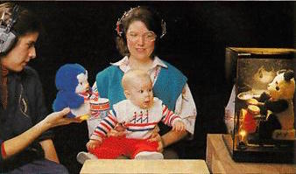

Conditioned Head Turn
Janet Werker Explains the conditional head turn procedure.
Used for infants older than 4 months.
Prof. Janet Werker
Department of Psychology at UBC
Interests: infant speech perception, acquisition of sound categories, speech perception and early word learning

Slide 74


